Slide 1
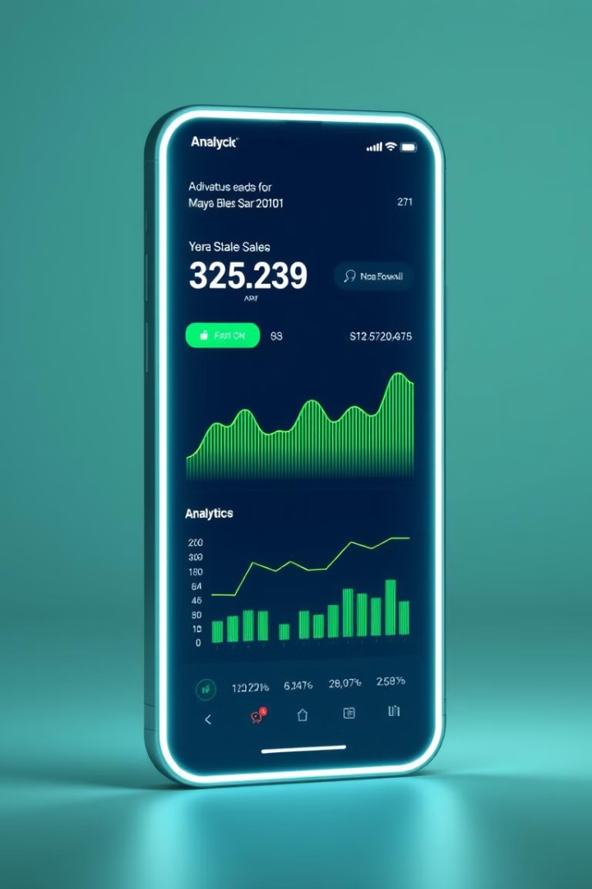
MobileMind: Enhancing Sales Intelligence
Data-driven strategies to optimize mobilemind sales performance. Key focus areas include data standardization, pattern identification, and dynamic visualization.
Abdul Ahad
Divya
Divanshi

Slide 2
Top Brands & Price Tiers
Leading Brands
Revenue by Price
Model Performance
Google and Nokia: revenue leaders
Premium tier drives revenue
256GB+ RAM models excel
Budget models contribute less
MediaTek Dimensity drives sales
Value and Volume have Positive
Co-relation

Slide 3
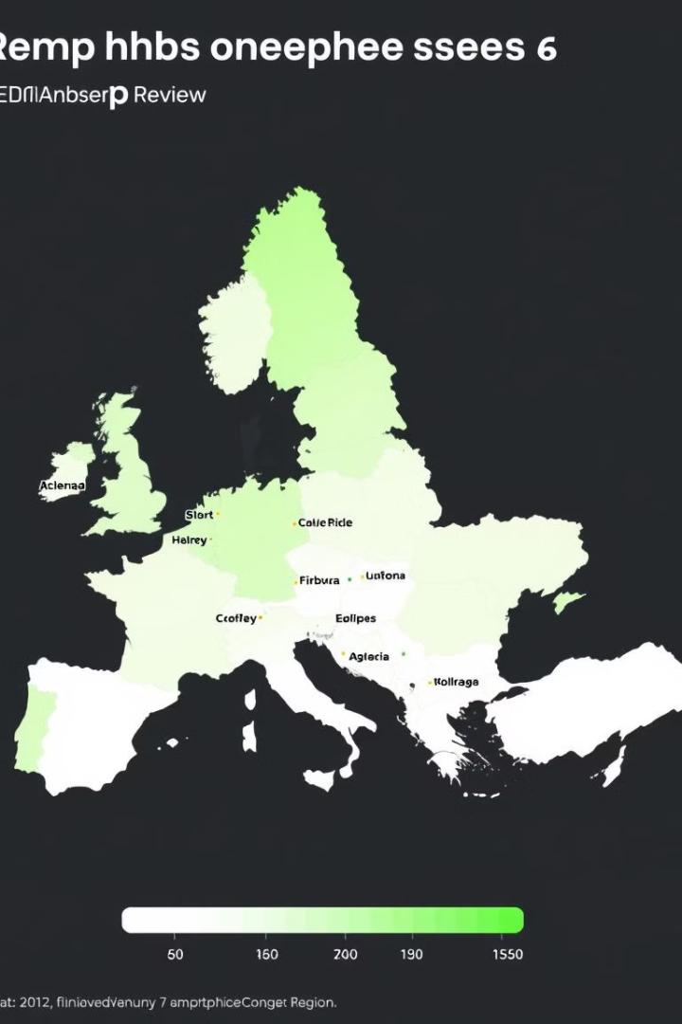

Regional & Delivery Insights
Regional Sales
West, South regions lead
Delivery Impact
30 days average delivery
Monthly Trends
March, August peak sales

Slide 4
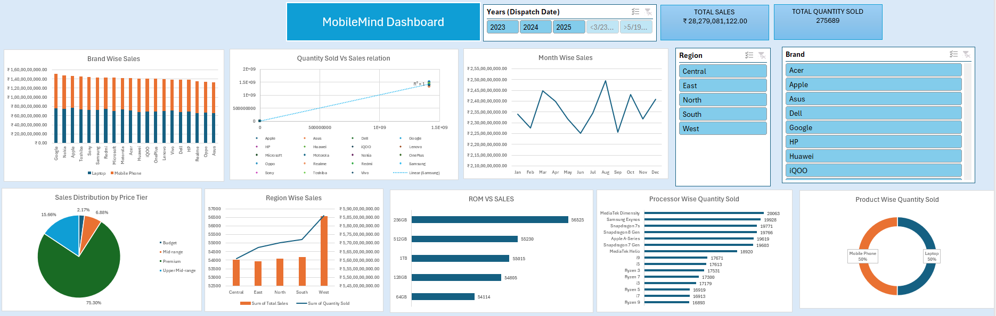
Dashboard

Slide 5





Strategic Recommendations
Focus on top models
MediaTek Dimensity, 256GB+ RAM
Improve market reach
Targeted campaigns in East, North
Faster deliveries
Ensure 10-15 faster deliveries with efficiency in logistic
Seasonal strategy
Align launches with peak months
Continuous monitoring
Regular dashboard tracking

